Slide 1
Draft
The ODU
and
The Genetic Code
Baba Aquair OmiYale Muhammad, PhD, Jan2015

Slide 2

Earth
0
0
Earth
Sky
Draft
1
1
0
0
1
0
v
2
0
3
0
0
0
0
0
4
1
v
1
1
Destiny
1
5
0
6
0
1
7
0
0
8
0
1
0
1
1
1
9
1
1
10
1
1
11
1
Sky
1
12
0
0
13
1
1
14
15
16

Slide 3
Earth
0
0
Earth
Sky
Draft
1
1
0
Ogbe
0
0
1
0
0
v
2
Ogunda
0
3
Irete
0
0
0
0
0
0
0
0
v
4
Irosun
1
1
1
1
1
1
Destiny
5
Otura
0
6
Oshe
0
1
1
1
1
0
1
0
1
1
1
0
1
0
0
0
0
7
Edi
0
0
8
Obara
0
0
1
1
1
1
0
1
0
1
1
1
9
Oyeku
10
Okanran
1
1
11
Sky
Oturupon
1
1
1
12
1
Oworin
0
0
13
Ika
1
1
14
Ofun
15
Iwori
16
Osa

Slide 4
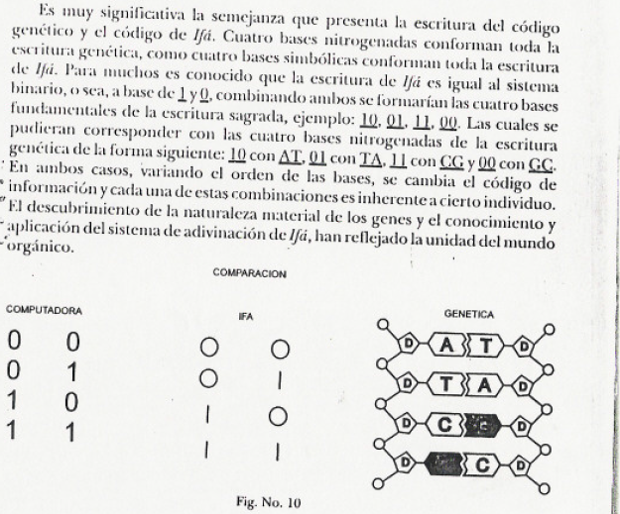
The parity found in the odu is found in the components of DNA¹
Draft
The figure to the right provides a comparison between binary parity generated by computer, IFA and Codons, the building blocks of DNA sequencing. A transpose transform is provided so that the columns of IFA become rows of codons in the DNA model.
Traditionally, IFA is read, right to left and top to bottom. With this is mind, the codons become
GG TA
CG TA
1. El Bàbálawo, Mèdico Tradicional, by Victor Bentancourt Ǫmǫlófaoró Estrada

Slide 5
Earth
0
0
Earth
Sky
Draft
1
1
0
1
0
0
0
0
1
Ogbe
2
1
1
1
1
0
v
0
Oyeku
Now rearranged according to tradition
1
0
0
1
3
Iwori
1
0
1
4
0
1
1
0
v
Edi
1
Destiny
0
1
0
0
1
1
5
Irosun
1
1
0
0
0
1
6
Oworin
0
1
1
1
Obara
7
0
0
1
1
1
0
8
Okanran
1
0
0
0
0
1
Ogunda
1
0
9
10
1
0
0
0
Osa
1
1
11
1
0
1
1
Ika
0
Sky
1
1
0
1
1
12
Oturupon
0
0
0
1
0
0
13
Otura
1
14
0
0
1
0
1
Irete
1
0
1
0
15
Ofun
0
0
1
1
16
Oshe

Slide 6
00~GC~G
(Guanine)
0
0
11~CG~C
(Cytosine)
Earth
Sky
Draft
1
Now using the transforms and color coding we find codons assignable to the principle ODU.
1
0
G
T
1
Ogbe
T
C
1
0
v
0
2
Oyeku
T
G
3
Iwori
1
0
1
4
v
Edi
1
Destiny
0
1
C
G
C
5
Irosun
G
C
T
G
C
6
Oworin
0
G
1
C
G
7
Obara
0
A
0
A
G
8
Okanran
1
T
A
0
Ogunda
1
T
A
9
0
T
A
C
10
Osa
1
T
1
11
Ika
G
0
1
12
Oturupon
A
0
0
13
Otura
T
C
1
1
10~AT~A
(Adenine)
14
Irete
01~TA~T
(Thymine)
15
Ofun
16
Oshe

Slide 7
With codons assigned to the principle ODU. A table can be formed for each of the 256 ODU and their DNA- codon assignments. This is simplified thru the use of color coding of codon pairs.
G
G
C
C
A
T
G
A
C
T
C
C
T
G
T
T
G
A
C
C
A
T
G
T
A
A
T
T
Draft
G
G
C
G
 |  | Ogbe | Oyeku | Iwori | Edi | Irosun | Oworin | Obara | Okanran | Ogunda | Osa | Ika | Oturupon | Otura | Irete | Oshe | Ofun
1 | Ogbe
2 | Oyeku
3 | Iwori
4 | Edi
5 | Irosun
6 | Oworin
7 | Obara
8 | Okanran
9 | Ogunda
10 | Osa
11 | Ika
12 | Oturupon
13 | Otura
14 | Irete
15 | Oshe
16 | Ofun
G
G
G
G
G
G
G
G
C
C
G
G
A
T
G
G
G
A
G
G
G
C
G
G
C
G
G
G
T
C
G
G
C
T
G
G
G
T
G
G
T
G
G
G
A
C
G
G
C
A
G
G
T
G
G
G
G
T
G
G
A
A
G
G
T
T
C
C
C
C
G
G
C
C
C
C
C
C
A
T
C
C
G
A
C
C
G
C
C
C
C
G
C
C
T
C
C
C
C
T
C
C
G
T
C
C
T
G
C
C
A
C
C
C
C
A
C
C
T
G
C
C
G
T
C
C
A
A
C
C
T
T
A
T
A
T
G
G
A
T
C
C
A
T
A
T
A
T
A
T
G
C
A
T
C
G
A
T
T
C
A
T
C
T
A
T
G
T
A
T
T
G
A
T
A
C
A
T
C
A
A
T
T
G
A
T
G
T
A
T
A
A
A
T
T
T
G
A
G
A
G
G
G
A
G
A
G
A
G
A
G
A
G
A
G
A
G
A
G
A
G
A
G
A
G
A
G
A
G
A
G
A
G
C
G
C
G
G
G
C
G
C
G
C
G
C
G
C
G
C
G
C
G
C
G
C
G
C
G
C
G
C
G
C
G
C
G
C
C
G
C
G
G
G
C
G
C
G
C
G
C
G
C
G
C
G
C
G
C
G
C
G
C
G
C
G
C
G
C
G
C
G
C
G
T
C
T
C
G
G
T
C
T
C
T
C
T
C
T
C
T
C
T
C
T
C
T
C
T
C
T
C
T
C
T
C
T
C
T
C
C
T
C
T
G
G
C
T
C
T
C
T
C
T
C
T
C
T
C
T
C
T
C
T
C
T
C
T
C
T
C
T
C
T
C
T
00 G
01 T
10 A
11 C
G
T
G
T
G
G
G
T
G
T
G
T
G
T
G
T
G
T
G
T
G
T
G
T
G
T
G
T
G
T
G
T
G
T
G
T
T
G
T
G
T
G
T
G
T
G
T
G
T
G
T
G
T
G
T
G
T
G
T
G
T
G
T
G
T
G
T
G
T
G
A
C
A
C
A
C
A
C
A
C
A
C
A
C
A
C
A
C
A
C
A
C
A
C
A
C
A
C
A
C
A
C
A
C
C
A
C
A
C
A
C
A
C
A
C
A
C
A
C
A
C
A
C
A
C
A
C
A
C
A
C
A
C
A
C
A
C
A
T
G
T
G
T
G
T
G
T
G
T
G
T
G
T
G
T
G
T
G
T
G
T
G
T
G
T
G
T
G
T
G
T
G
G
T
G
T
G
T
G
T
G
T
G
T
G
T
G
T
G
T
G
T
G
T
G
T
G
T
G
T
G
T
G
T
G
T
A
A
A
A
A
A
A
A
A
A
A
A
A
A
A
A
A
A
A
A
A
A
A
A
A
A
A
A
A
A
A
A
A
A
T
T
T
T
T
T
T
T

Slide 8
00~GC~G
11~CG~C
Earth
Sky
Draft
1
Ogbe
v
2
Oyeku
3
Iwori
v
4
Edi
Destiny
5
Irosun
6
Oworin
7
Obara
8
Okanran
9
Ogunda
10
Osa
11
Ika
12
Oturupon
13
Otura
10~AT~A
14
Irete
01~TA~T
15
Ofun
16
Oshe

